Slide 1

The following short quiz consists of 4 questions and tells whether you are qualified to be a "professional".
The questions are not that difficult, so don’t cheat by looking ahead!.

Slide 2



Question Number 1
How do you put a giraffe into a refrigerator?

Slide 3


The correct answer is:
Open the refrigerator, put in the giraffe and
close the door.
This question tests whether you tend to do simple things in an overly complicated way.

Slide 4
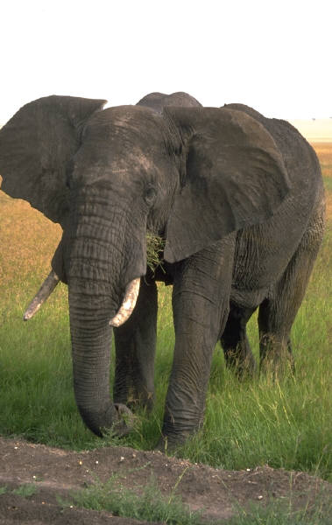
Question Number 2
How do you put an elephant into a refrigerator?

Slide 5

Wrong Answer: Open the refrigerator, put in the elephant and close the refrigerator.
Correct Answer:
Open the refrigerator, take out the giraffe, put in the elephant and close the door.
This tests your ability to think through the repercussions of your actions.

Slide 6

Question Number 3
The Lion King is hosting an animal conference. All the animals attend except one. Which animal does not attend?

Slide 7
Correct Answer:
The Elephant.
The Elephant is in the refrigerator.
Remember?
This tests your memory.

Slide 8

OK, even if you did not answer the first three questions correctly, you still have one more chance to show your abilities.

Slide 9


Question Number 4
There is a river you must cross. But crocodiles inhabit it.
How do you manage it?

Slide 10

Correct Answer: You swim across. Why?
All the Crocodiles are attending the Animal Conference.
This tests whether you learn quickly from your mistakes.

Slide 11
According to Andersen Consulting Worldwide, around 90% of the professionals they tested got all questions wrong.
But many preschoolers got several correct answers.
Anderson Consulting says this conclusively disproves the theory that most professionals have the brains of a four year old.

Slide 12
Send this out
to frustrate
all of your friends

